Slide 2

Unit 6: Managing and Customizing
Interactive Reports

Slide 3
Lesson Objectives
After completing this lesson, you should be able to:
Describe interactive report components
Use and customize an interactive report as an end user
Manage interactive report attributes
Configure the display of interactive report controls as a developer
Notes:
This lesson is divided in to two parts: Part 1 and Part 2. In part 1, you learn how to use and customize an interactive report as an end user. Part 2 deals with how to customize an interactive report as a developer.

Slide 4

Part 1:Customizing an Interactive Report as an End User
Notes:
In Part 1, you learn how to use and customize an interactive report as an end user. You learn how to:
Add column and row filters
Sort columns
Highlight rows
Create control breaks
Add a chart
Create a Pivot report, and Group By report
Perform a flashback query
Save and download a report

Slide 5
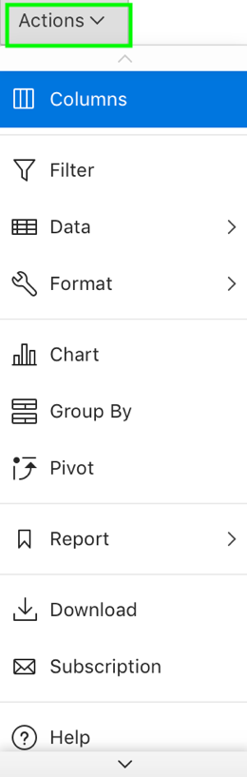
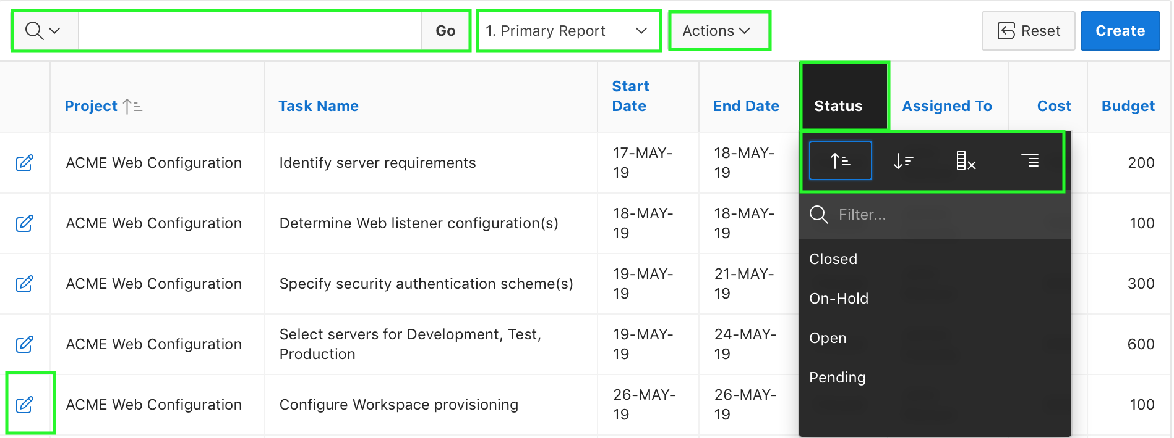
Using Interactive Report Components
Actions Menu
Search Bar
Saved Reports
Column Heading Menu
Link Column
Notes:
An interactive report is contained in a page within a database application. To access an interactive report you must go to the database application URL, log in using your account credentials (that is, your username and password), and then navigate to the report page.
Interactive reports enable end users to create highly customized reports. Users can alter the report layout by hiding or exposing specific columns and applying filters, highlighting, and sorting. They can also define breaks, aggregations, charts, group data, and add their own computations. Once customized, the report can be saved as either a private or public report. Most interactive reports include a search bar, Actions menu, Column Heading menu, and edit icons in the first column of each row.
The slide shows components of an interactive report.
Search bar: The search bar displays above interactive report and provides features such as the Select Columns icon, Text Area, Go button, and the Actions menu button.
Column heading menu: Click any column heading to see a column heading menu. This menu allows you to change the sort order, hide columns, create break groups on a column, view Help text about the column, and create a filter.
Saved reports: You can create and save alternative views of a report.
Actions menu: The Actions menu appears to the right of the Go button on the Search bar. End users use the Actions menu to customize an interactive report. Actions menu includes Data, Format, and Reports submenus.
Link to custom target: You can link to another page in your application.

Slide 6
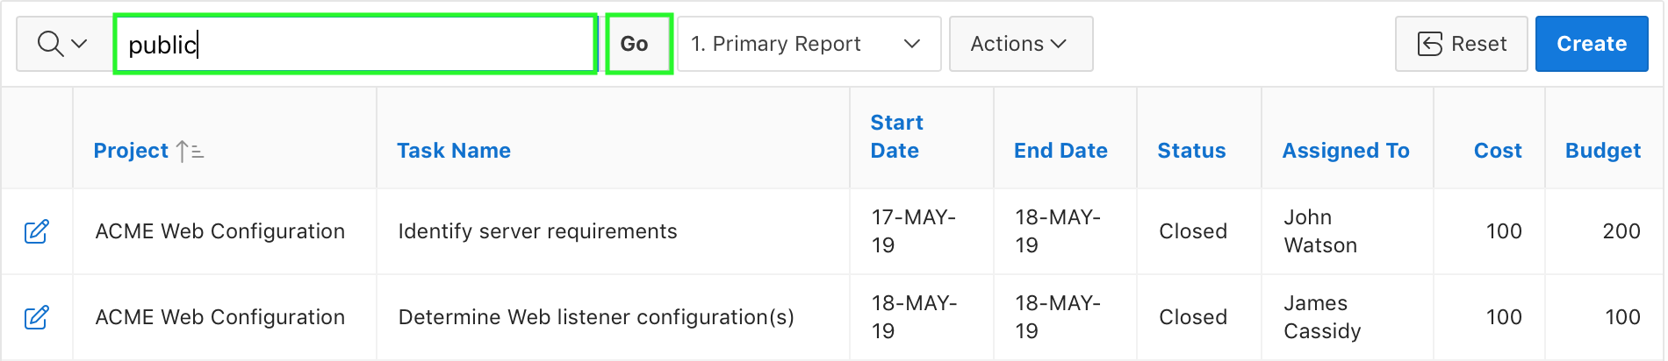
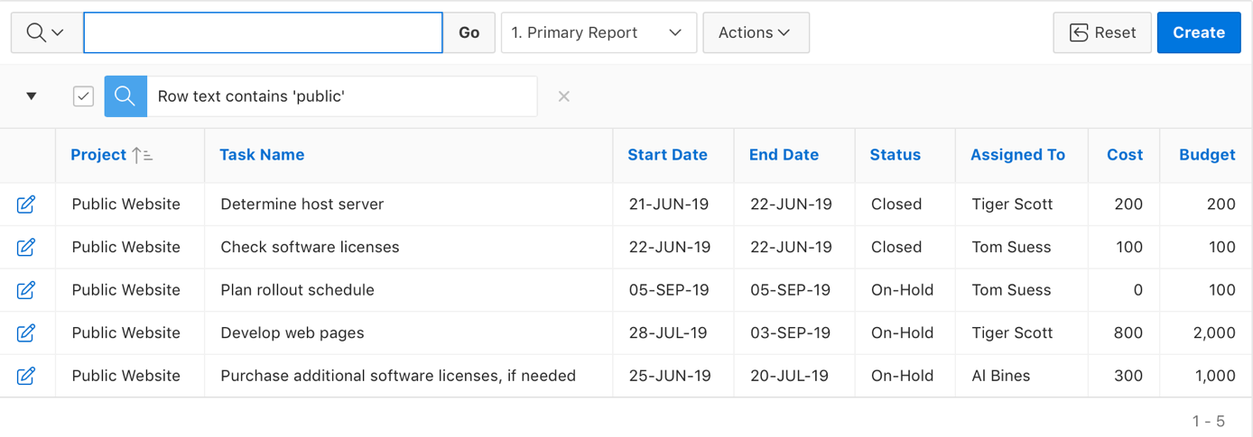
Searching for Information in an Interactive Report
Enter your search criteria in the text area and click Go.
All rows that contain the search criteria are displayed.
Notes:
The slide example shows performing a search on the entire interactive report. Application Express allows you to perform a non-case-sensitive search on the entire interactive report or on a specific column.
In the slide example, you enter 'public' in the text area and click the Go button. Application Express performs a search on the entire interactive report and displays all rows that include the text 'public' and also creates a filter named Row text contains 'public'.
To perform a search in the entire interactive report, enter your search criteria in the text area and click Go. A filter is applied on the report and all the rows that contain the search criteria are displayed.
To remove the filter, click the Remove Filter icon (red X) next to the filter that you want to remove. Alternatively, you can enable or disable the filter by using the Enable/Disable check box.
Note: When you search for information using the Search bar, you create a filter. You can also use the Filter option from the Actions menu to add or modify a filter.

Slide 7
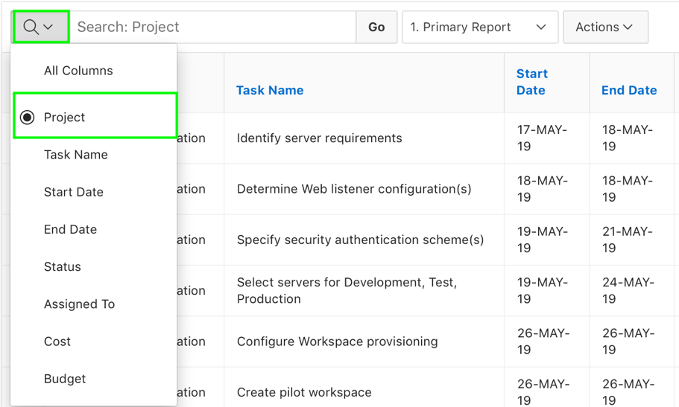
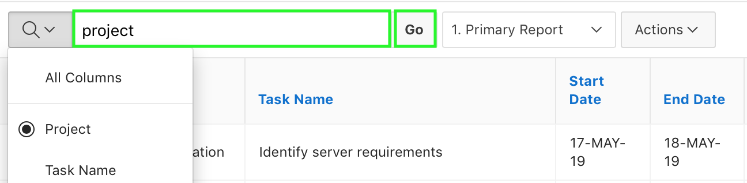
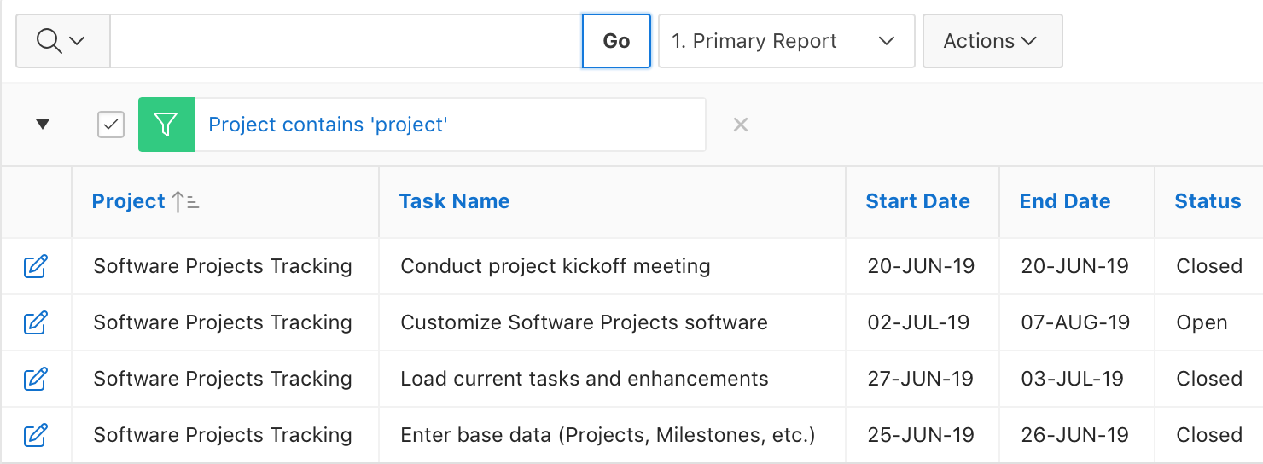
Searching for Information Within a Specific Column
Select columns to search
1
2
3
Search performed within the selected column
Notes:
The slide shows an example of searching the report within a specific column, Project. Application Express searches within the Project column and displays all rows that contain the text 'public' and creates a filter named 'Project contains public'.
To search within a specific column, perform the following steps:
1. The Select columns to search icon displays to the left of the search bar. Click this icon to display a listing of all columns in the current report. Select the column to search on
2. Enter key words in the text area and click Go.
3. The search is applied and the results are displayed.
Application Express allows you to create multiple filters on a report. For a row to be displayed, the row must satisfy all the filters (an AND condition is implied).
Note: As an alternative to this approach, you can even search using Column Heading Menu – Filter…

Slide 8
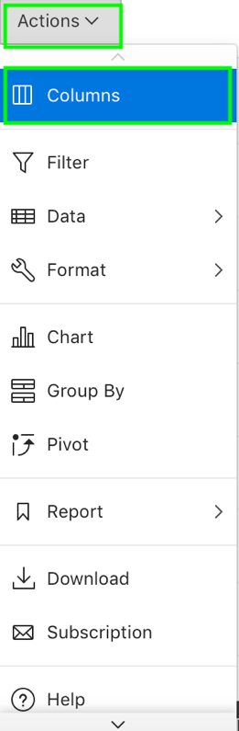
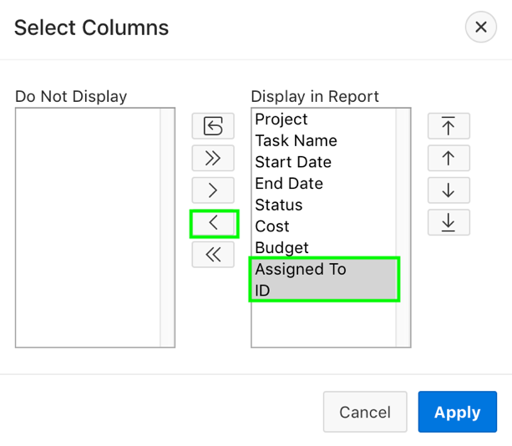
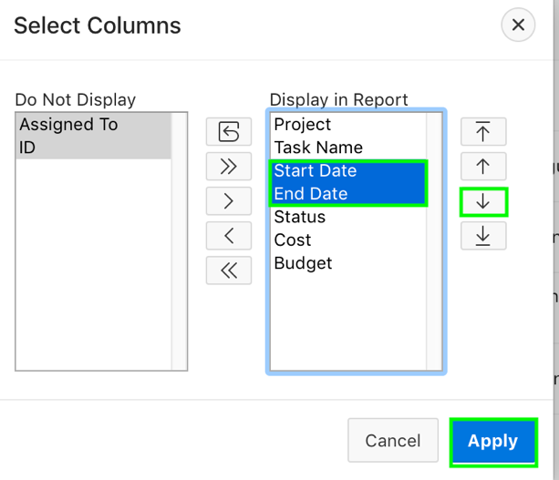
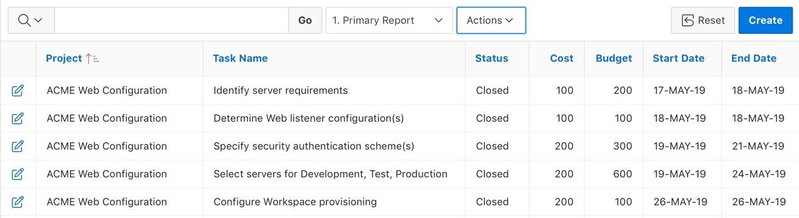
Selecting Columns To Display
1
2
3
Reordering columns
4
Notes:
End users can customize their report to include specific columns and also can decide the order in which the columns appear in the report. The slide example shows using the Select Columns option under the Actions menu to choose columns that you want to display in your interactive report. In the example, you do not want to display the Assigned To and Available Budget columns in the report. And also, you move the Start Date and End Date columns so that they are displayed after the Budget column.
To customize your report to include specific columns, perform the following steps:
Click the Actions menu and select Columns. The Select Columns dialog appears.
Select the columns you want to move. Click the center arrows to move a column from Display in Report to Do Not Display. To select multiple columns at once, press and hold the CTRL key.
To change the order of the columns, click the Top, Up, Down, and Bottom arrows on the right. Click Apply.
A revised report appears.
Note: You can use Column Heading Menu to hide a column.

Slide 9
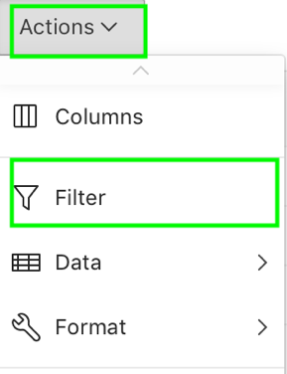
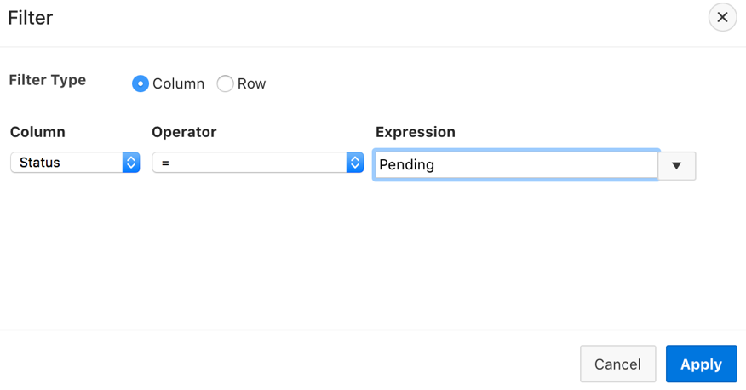
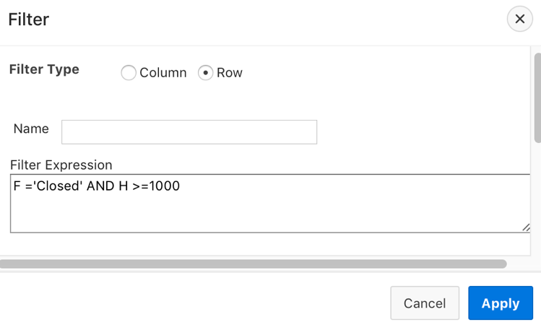
Adding a Filter in an Interactive Report
You can create two types of filters in an interactive report:
Column Filter
Row Filter
Notes:
End users can create row and column filters on an interactive report. You can create two types of filters:
Column: Creates a custom column filter. Select a column, select a standard Oracle operator (=, !=, not in, between), and enter an expression to compare against. Expressions are case sensitive. Use the percent sign (%) as a wildcard. Note that the selected column does not need to be one that currently displays. For example: STATE_NAME like A%
Row: Creates a custom row filter. This filter creates a complex WHERE clauses using column aliases and any Oracle functions or operators. For example: G = 'VA' or G = 'CT' (Where G is the alias for CUSTOMER_STATE)
To add a column filter or a row filter, you use the Actions menu and select Filter. The next two slides include examples of creating a column and row filter.

Slide 10
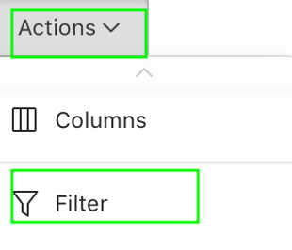
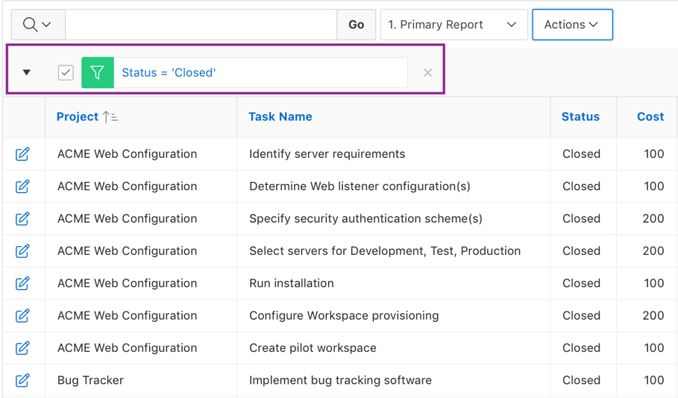
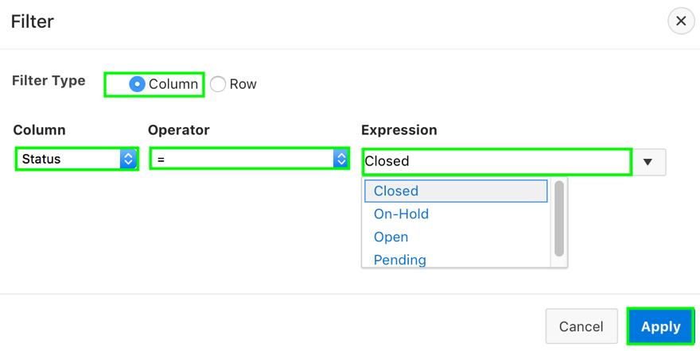
Adding a Column Filter
1
2
Notes:
Use the Actions menu to add, edit, or remove a column filter in an interactive report.
To add a column filter, perform the following steps:
Click the Actions menu and select Filter. The Filter dialog appears.
For Filter Type, select Column. In the Filter region, specify a column, an operator, and an expression and click Apply. For example, in the slide, you select Status for column, and = for Operator. From the Expression list, you select Closed.
Notice the filter that displays in the Report Settings area above the report. You can show or hide the filter details by clicking the arrow to the left of the filter name. To revise the filter, click the filter name. Edit your selections and click Apply. To disable the filter, select the Enable/Disable Filter check box.
To delete the filter, click Remove Filter.

Slide 11
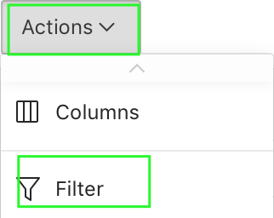
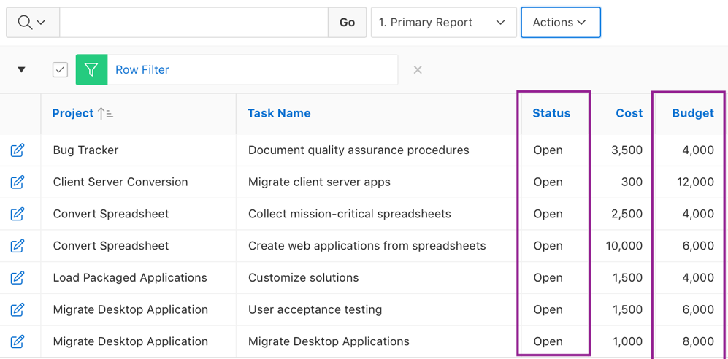
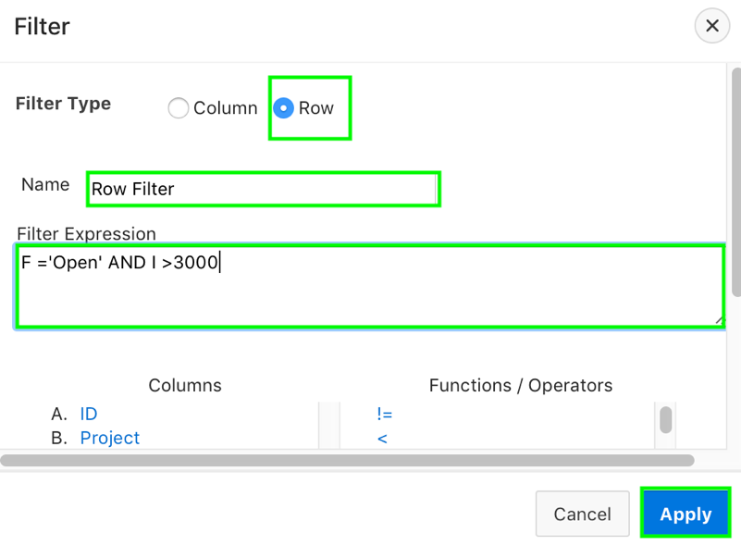
Adding a Row Filter
1
2
Notes:
The slide example shows applying a row filter to display projects with Open status and budget greater than 3000. You use the Actions menu to add, edit, or remove a row filter in an interactive report.
To add a row filter, perform the following steps:
Click the Actions menu and select Filter. The Filter dialog appears.
For Filter Type, select Row. In the Filter dialog:
Name - Enter a name that describes this filter.
Filter Expression - Enter an expression. Select a column and function or operator at the bottom of the region. In the slide example, you select F='Open' AND I>3000.
Click Apply.
Notice the filter that displays in the Report Settings area above the report. You can show or hide the filter details by clicking the arrow to the left of the filter name. To revise the filter, click the filter name. Edit your selections and click Apply. To disable the filter, select the Enable/Disable Filter check box.
To delete the filter, click Remove Filter.

Slide 12
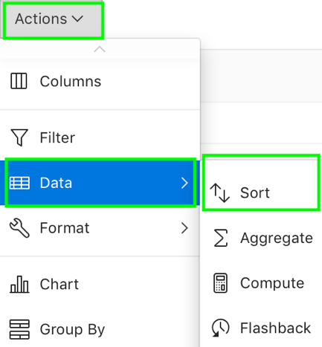
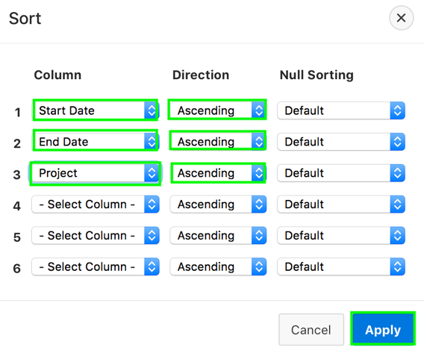
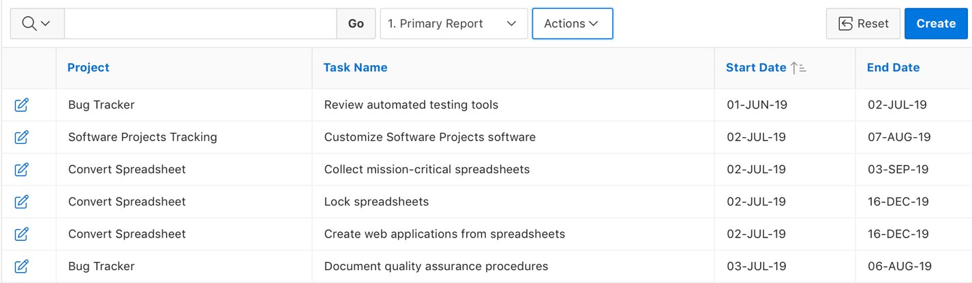
Selecting Column Sort Order
1
2
Notes:
End users can specify column display sort order (ascending or descending) in an interactive report by selecting Sort on the Data submenu. You can also specify how to handle NULL values. Using the default setting always displays NULL values last or always displays them first.
To sort by column, perform the following steps:
Click the Actions menu and select Data and then Sort. The Sort dialog appears.
Select a column, the sort direction (Ascending or Descending), and Null Sorting behavior (Default, Nulls Always Last, or Nulls Always First). Click Apply. In the slide example, you select Start Date, End Date and Project columns in sequence with Ascending sort direction.
You can also sort by using the column header.
Note: You can use the Column Heading Menu to sort a single column in ascending or descending order.

Slide 13
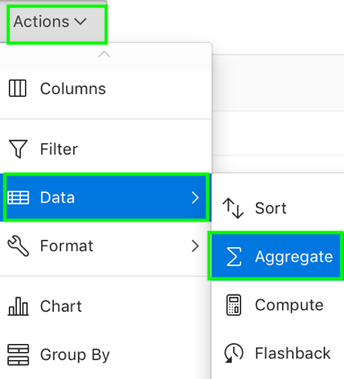
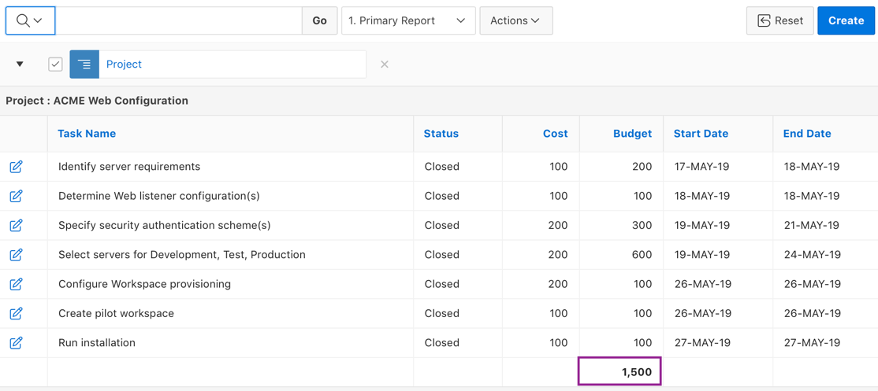
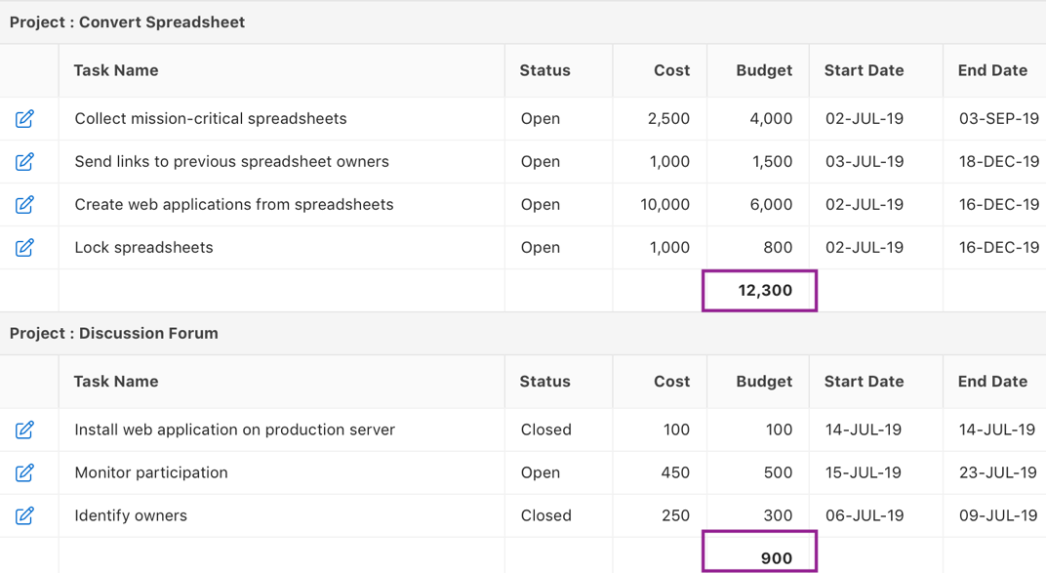
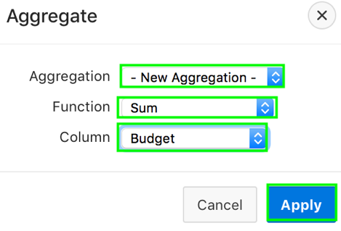
Creating an Aggregation Against a Column
1
Sum of Budget
2
Sum of Budget
Notes:
End users define an aggregation against a column with the Actions, Data submenu. Aggregates are displayed after each control break and at the end of the report within the column for which they are defined.
The slide example shows a control break created on the Project column. An aggregation is created against the Budget column. Therefore, sum of budget is displayed after each control break.
To create an aggregation against a column, perform the following steps:
Click the Actions menu and select Data and then Aggregate.
The Aggregate dialog appears. In the Aggregate dialog:
Aggregation - Select New Aggregation.
Function - Select among these functions: Sum; Average, Count, Count Distinct, Minimum, Maximum, or Median. In the slide, you select Sum.
Column - Select a column. For example, in the slide, you select Budget.
Click Apply.
The aggregation appears at the bottom of the last page of the report. In this example, the aggregate shows the sum of all amounts in the Budget column for each of the break up applied on the Project column. You learn more about control breaks later in this lesson.
To remove an aggregation, open the Aggregate dialog by navigating to Actions > Data > Aggregate menu.

Slide 14
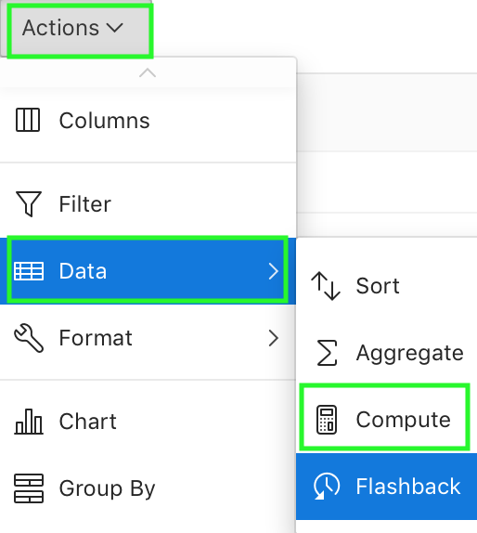
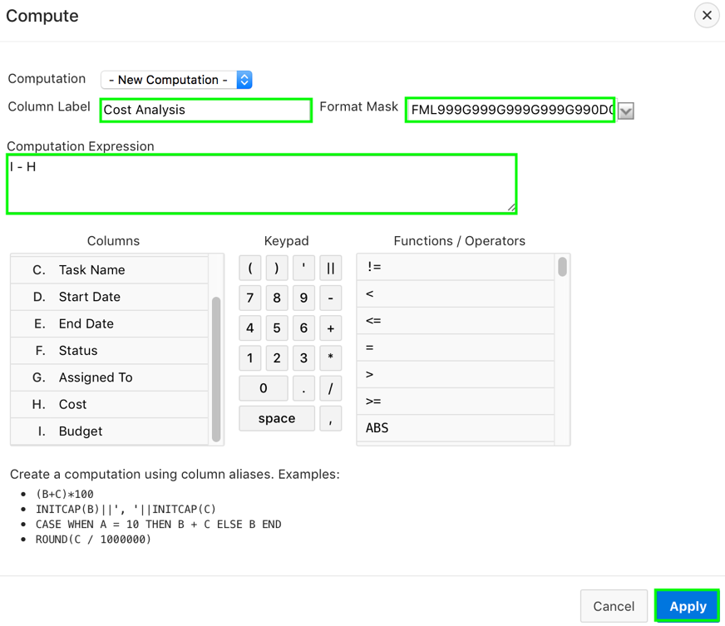
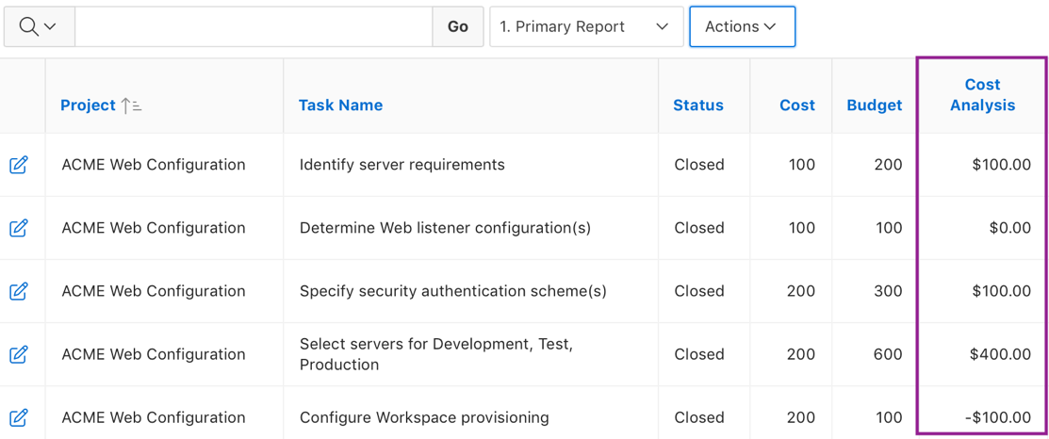
Adding a Computed Column
1
2
Computed column
Notes:
End users can add a computation to a column in an interactive report. You use the Compute function in the Actions, Data submenu to add a computation to a column. In the slide example, you add a new column that compares the actual cost to the budgeted amount, using the formula I - H, where I is the budgeted amount and H is the cost. The revised report appears containing a new Cost Analysis column.
To create a computation, perform the following steps:
Click the Actions menu and select Data and then Compute. The Compute dialog appears.
In the Compute dialog:
Computation - Select New Computation.
Column Heading - Enter the name of the new column to be created.
Format Mask - Select an Oracle format mask to be applied to the new column. (For example, $5,234.10).
Computation Expression – Specify a computation expression using the Columns, Keypad and Functions/Operators.
Click Apply. The revised report appears containing the new computed column.
To delete a computation:
Click the Actions menu and select Data and then Compute.
From Computation, select the computation you want to delete. The computation appears.
Click Delete.

Slide 15
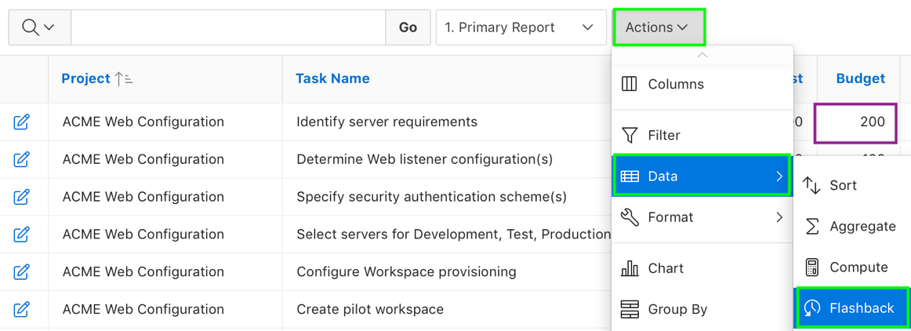
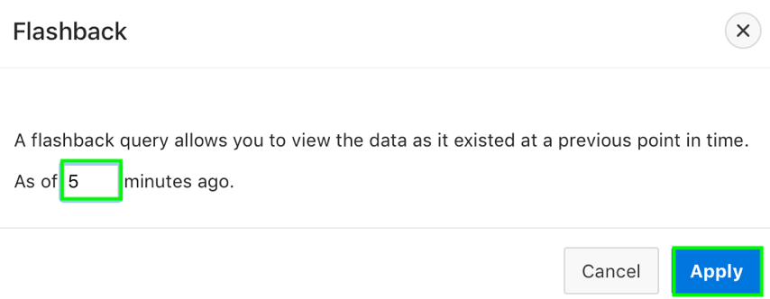
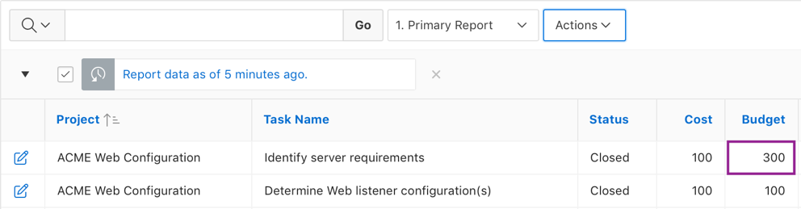
Performing a Flashback Query
1
2
Data that existed 5 minutes ago
Notes:
End users can execute a flashback query by selecting Flashback from the Actions, Data submenu. A flashback query enables you to view the data as it existed at a previous point in time. The default amount of time that you can flashback is 3 hours (or 180 minutes) but the actual amount is different for each database.
The slide example shows executing a flashback query to retrieve report data that existed 5 minutes ago.
To execute a flashback query, perform the following steps:
Click the Actions menu and select Data > Flashback.
In the Flashback field, enter the number of minutes. Click Apply. Note that the flashback query filter is named as Report data as of n minutes ago.

Slide 16
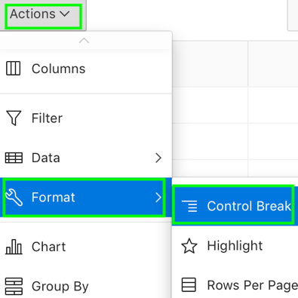
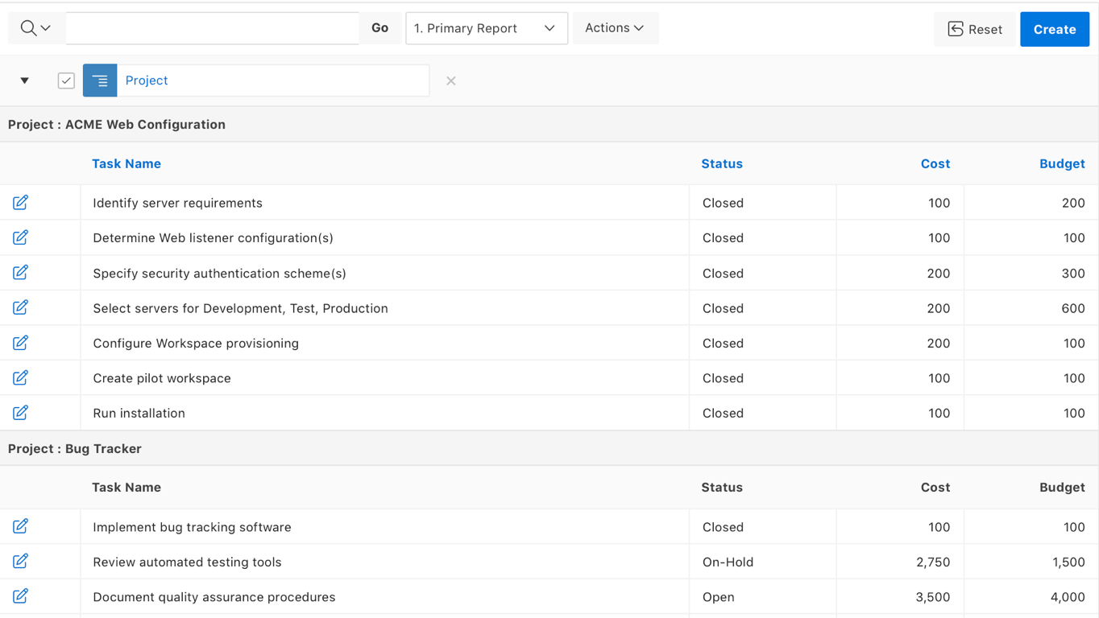
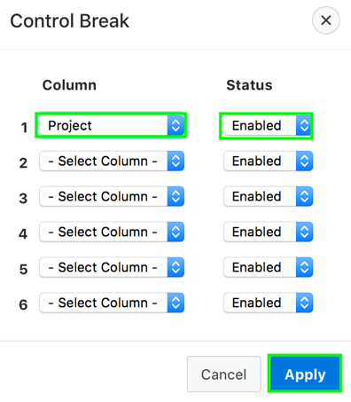
Creating a Control Break
1
Control break on the Project column
2
Notes:
End users can create a break group of one or several columns by selecting Actions, Format, and Control Break. Creating a break group pulls the columns out of the interactive report and displays them as a master record.
The slide example creates a control break on Project column. Notice that the Project column is extracted from the report and displayed as a master record.
To create a break group, perform the following steps:
Click the Actions menu and select Format and then Control Break. The Control Break dialog appears.
Select a column and then a status (Enable or Disable). Click Apply. A revised report displays.
Note the defined filter displays in the Report Settings area above the report. To disable the Control Break filter, deselect the Enable/Disable Filter check
box. To activate a disabled filter, select the Enable/Disable Filter check box again. To delete the filter, click Remove Control Break.
Note: You can use Column Heading Menu to create a break on a single column.

Slide 17
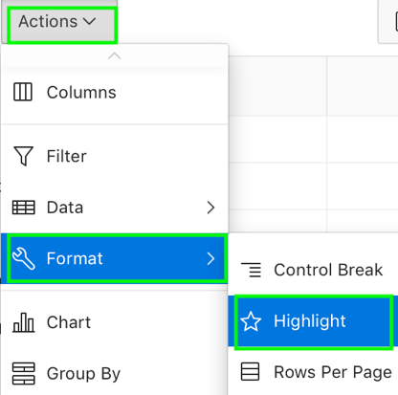
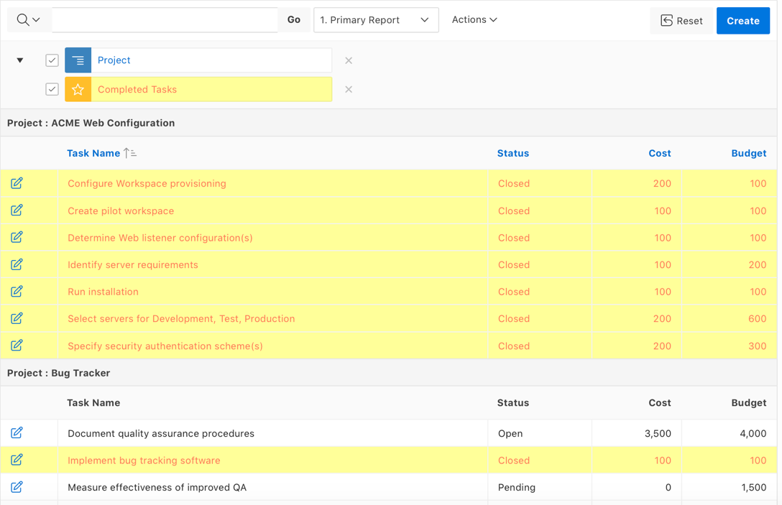
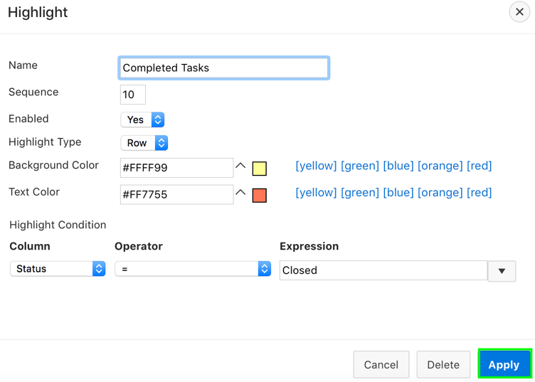
Adding Highlighting in an Interactive Report
1
Rows with Status 'Closed' are highlighted
2
Notes:
End users can customize the display to highlight specific rows in a report by selecting Highlight on the Actions, Format submenu.
To add highlighting, perform the following steps:
Click the Actions menu and select Format and then Highlight. The Highlight dialog appears.
Edit the following information:
Name - Enter a name that describes this filter. In the slide example, enter Completed Tasks
Sequence - Enter a numeric value to identify the sequence in which highlighting rules are evaluated.
Enabled - Select Yes.
Highlight Type - Select Cell or Row. In the slide, select Row.
Background Color - Select a new color for the background of the highlighted area. In the slide, select yellow.
Text Color - Select a new color for the text in the highlighted area. In the slide, select red.
Highlight Condition - Select a column, an operator, and expression. In the slide, select Status for Column, = for Operator, and Closed from the Expression list.
Click Apply. Note the highlight Completed Tasks displays in the Report Settings area above the report. You can show or hide the filter details by clicking the arrow to the left of the filter name.

Slide 18
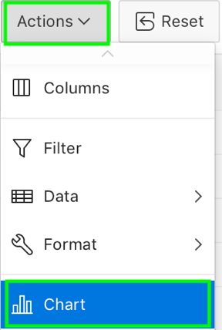
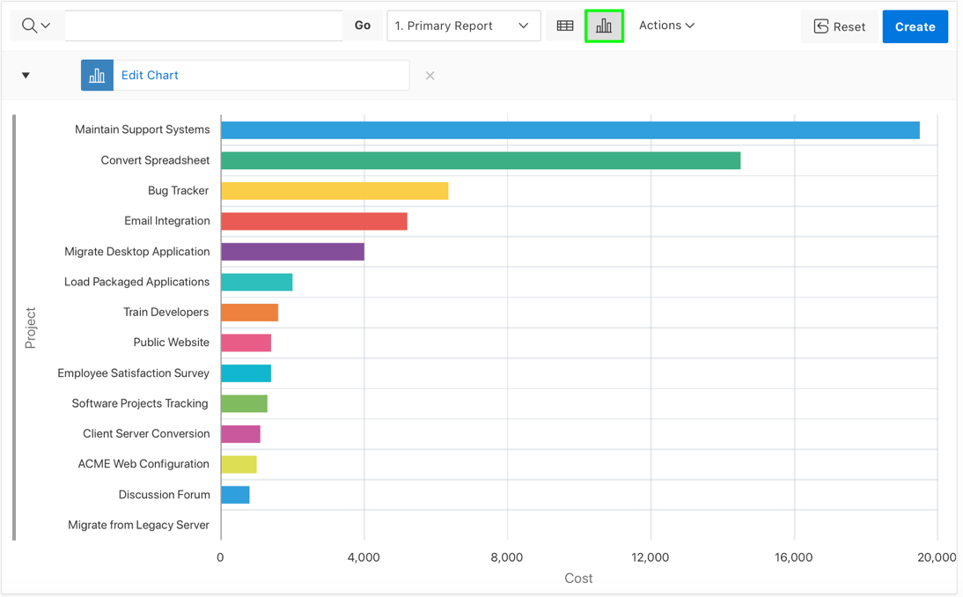
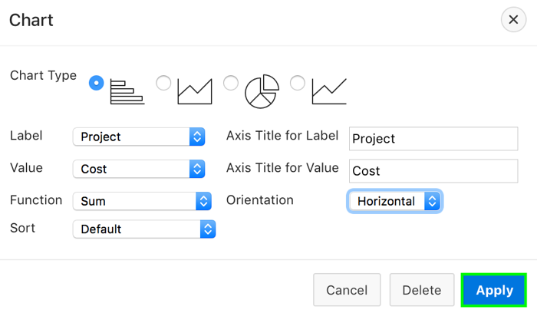
Creating a Chart
1
View Report
View Chart
2
Notes:
You can create charts in an interactive report with the Chart function in the Actions menu. You can create one chart for each interactive report. Once defined, you can toggle between the chart and report views using the View Report and View Chart on the Search bar.
The slide example creates a horizontal bar chart. To create a chart, perform the following steps:
Click the Actions menu and select Chart. The Chart dialog appears.
In the Chart dialog, specify the appropriate options.
Chart Type - Select the type of chart you want to create (horizontal bar, vertical bar, pie, or line). In the slide, you select horizontal bar.
Label - Select the column to be used as the label. In the slide, you select Project.
Axis for Title for Label - Enter the title to display on the axis associated with the column selected for Label (not available for pie chart)
Value - Select the column to be used as the Value. If your function is a COUNT, a Value does not need to be selected. In the slide, you select Cost.
Axis Title for Value - Enter the title to display on the axis associated with the column selected for Value (not available for pie chart).
Function - (Optional) Select a function to be performed on the column selected for Value. In the slide, you select Sum.
Sort - Select a sorting method.
Orientation – Specify if you want the chart orientation to be horizontal or vertical. In the slide example, you select Horizontal.
Click Apply. The chart appears.

Slide 19
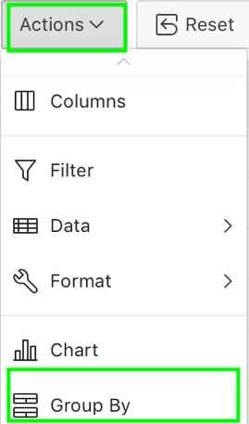
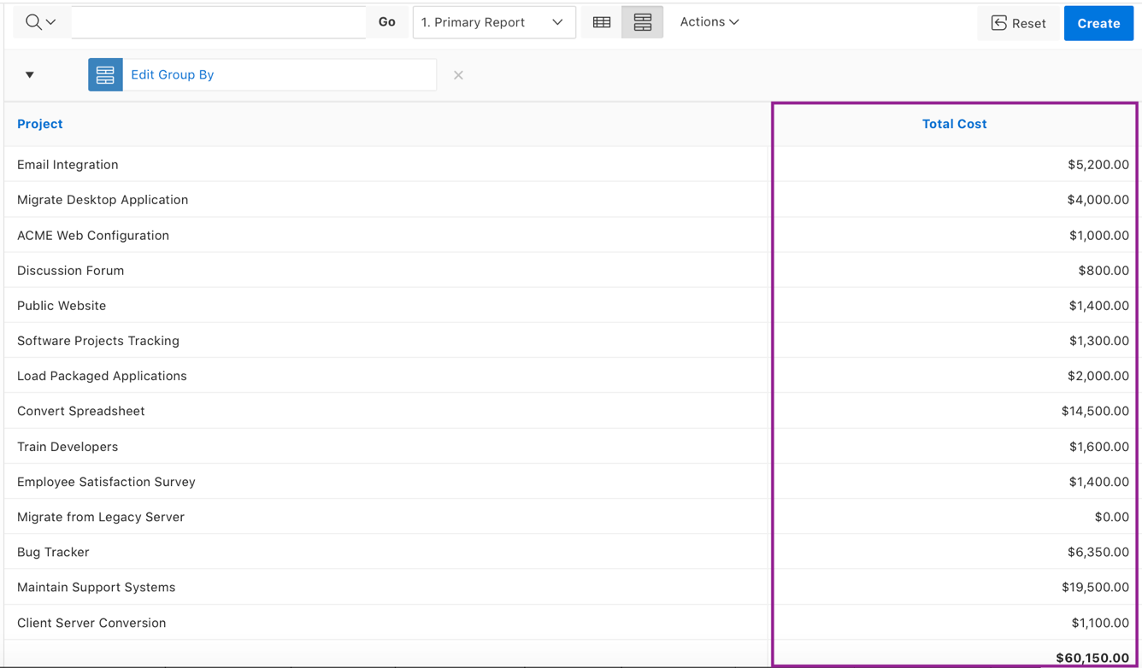
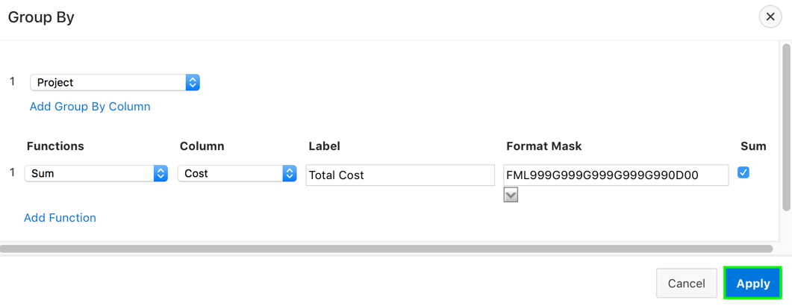
Creating a Group By
1
2
Notes:
End users can group sets of results by one or more columns with the Group By function, and then perform mathematical computations against the columns. Once you define the Group By, you can switch between the group by and report views using the View Group By and View Report icons in the Search bar.
To reorganize an interactive report by using Group By, perform the following steps:
Click the Actions menu and select Group By. The Group By dialog appears.
In the Group by dialog:
Select a column to display. To add additional columns, click Add Group By Column. In the slide, you select Project column.
Select the function, column, label, and format mask. To create a sum, click the Sum check box. To add another function, click Add Function. In the slide example, you select Sum from the Functions list, Cost for Column, and enter Total Cost as Label. You also select a format mask and click the Sum checkbox.
Click Apply.
A Group By icon appears to the left of the Actions menu. The resulting report displays the Project column and the new Total Cost column.

Slide 20
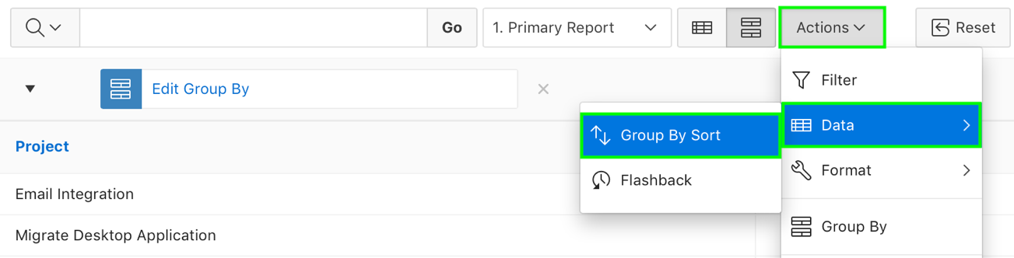
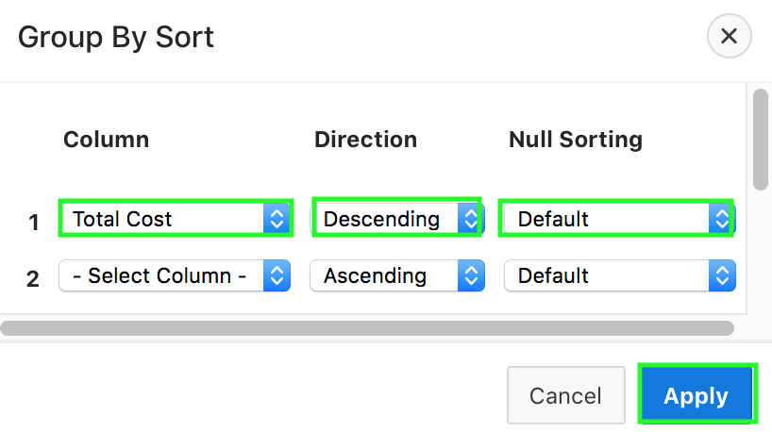
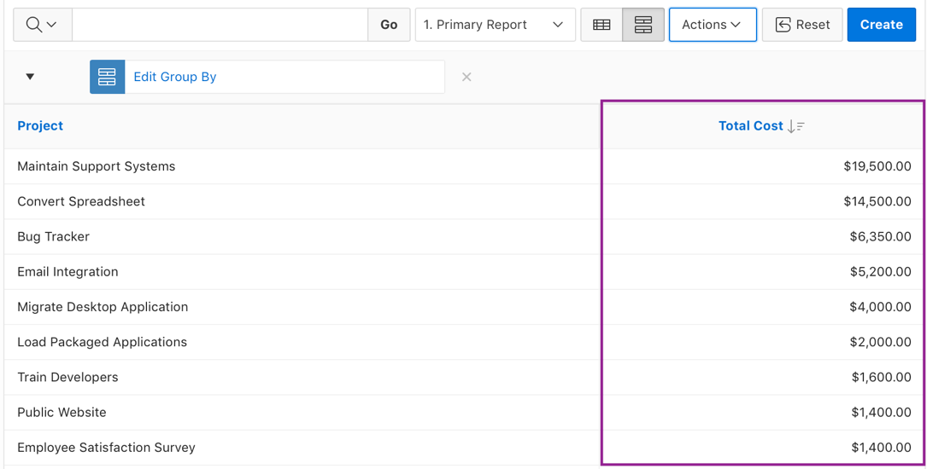
Specifying a Group By Sort Order
1
2
Notes:
You can specify group by column sort order (ascending or descending) by either clicking on the group by column heading or selecting Group By Sort from the Actions > Data submenu. The Group By Sort menu is only visible when you are viewing Group By view.
You can also specify how to handle NULL values. Using the default setting always displays NULL values last or always displays them first.
To sort a group by column, perform the following steps:
Access a Group By view. Then, click the Actions > Data submenu and select Group By Sort. The Group By Sort dialog appears.
Select a column, the sort direction (Ascending or Descending), and Null Sorting behavior (Default, Nulls Always Last, or Nulls Always First).
Click Apply.
In the slide example, you select Total Cost for Column, Descending for Direction, and Default for Null Sorting.
You see that the report is sorted in descending order of the total cost.

Slide 21
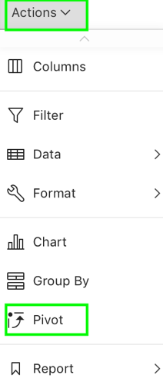
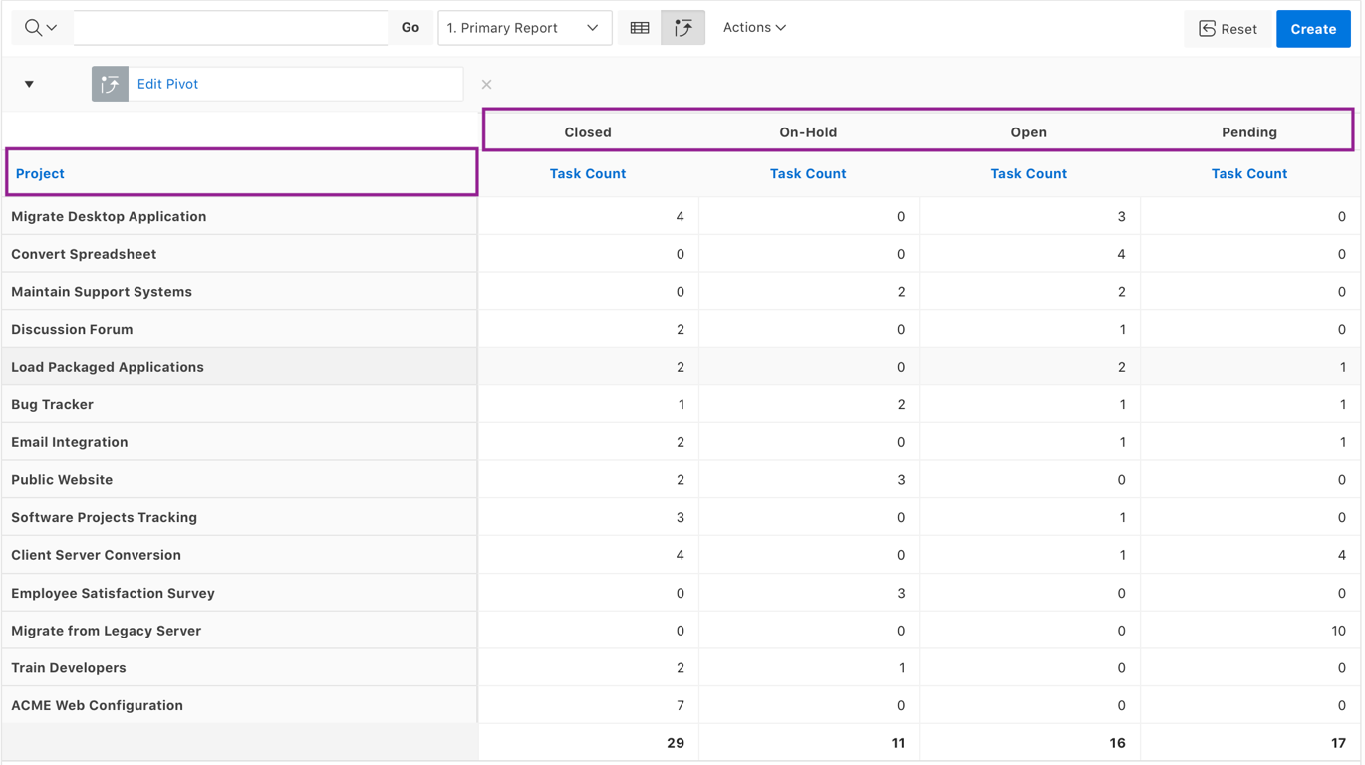

Creating a Pivot Report
1
Row Column
Pivot Column
2
Notes:
Pivot reports transpose rows into columns to generate results in a crosstab format. You select pivot columns and rows and then provide the functions to be represented in the pivot report. Once created, pivot reports display a new icon in the search bar.
The slide example shows a Pivot report that displays the number of closed, on-hold, open, and pending tasks associated with each project.
To create a pivot report, perform the following steps:
Click the Actions menu and select Pivot. The Pivot dialog appears.
In the Pivot dialog:
Pivot Columns - Select the columns to display. In the slide example, select Status. To add additional columns, click Add Pivot Column.
Row Columns - Select the rows to display. In the slide example, select Project. To add additional columns, click Add Row Column.
Computation - Select a function, column, label, and format mask. To create a sum, click the Sum check box (optional). In the slide example, you select Count for Functions, Task Name for Column, and specify the label as Task Count.
Click Apply.

Slide 22



Saving an Interactive Report
1
2
Notes:
You can save an interactive report for future use. Note that while navigating between pages in an application, if you select the report, your changes will still be available. However, upon logging out from the application, your changes will not be saved unless you have saved the report. You can save multiple versions of a report and each will appear as a separate report.
The ability to save an interactive report is configurable by the application developer who creates the interactive report.
End users can save an interactive report and classify it as Public or Private.
Public Report: A Public report can be saved, renamed, or deleted by the end user who created it. Other users can view and save the layout as another report.
Private Report: Only the end user that created the report can view, save, rename or delete the report.
To save a public or private interactive report, perform the following steps:
Go to the page containing the interactive report you want to save. Click the Actions menu and select Report then Save Report. The Save Report dialog appears.
In Save Report:
Save - Select either As Named Report or As Default Report Settings option. This option is available for only developers. The slide example shows this option.
Name - Enter a name for the report.
Description - Enter an optional description.
Public - Select this check box to make the report viewable to all users. Deselect this check box to make the report private.
Click Apply.

Slide 23



Resetting a Report
After reset
Notes:
You can reset a report back to the default settings. Resetting a report removes any customizations you have made. The slide example shows that the customizations made to the report are lost upon selecting the Reset option.
You can reset a report by selecting Reset from the Actions, Report submenu.

Slide 24



Downloading a Report
1
2
Notes:
You can download an interactive report by selecting Download from the Actions menu. Available download formats depend upon your installation and report definition. Supported formats include comma-delimited file (CSV) format, HTML, Email, Microsoft Excel (XLS) format, Adobe Portable Document Format (PDF), and Microsoft Word Rich Text Format (RTF).
The ability to download an interactive report is configurable by your application developer. The slide shows all of the available formats. In the example, you select CSV.
To download a report, perform the following steps:
Click the Actions menu and select Download.
Select a report download format and follow the provided instructions.

Slide 25

Using the Column Heading Menu
Sort Descending
Hide Column
Control Break
Sort Ascending
Notes:
Clicking a column heading in an interactive report displays the Column Heading menu. Positioning the cursor over each icon displays a tooltip that describes its function.
Column Heading menu options include:
Sort Ascending - Sorts the report by the column in ascending order.
Sort Descending - Sorts the report by the column in descending order.
Hide Column - Hides the column. Not all columns can be hidden. If a column cannot be hidden, the Hide Column icon does not display. To show a hidden column, select Reset from the Actions menu.
Control Break - Creates a break group on the column. This pulls the column out of the report as a master record.
Column Information - Displays help text about the column, if available.
Filter - Enter a case insensitive search criteria. Entering a value reduces the list of values at the bottom of the menu. You can then select a value from the bottom. The selected value will be created as a filter using either the equal sign (=) or contains depending on the List of Values Column Filter Type.

Slide 26

Part 2: Customizing an interactive report as a developer
Notes:
By default, an interactive report includes a search bar, an Actions menu, a Column Heading menu, and Edit icons in the first column of each row. Users can use these controls to alter the layout of report data by selecting columns, applying filters, highlighting, and sorting. Developers can customize an interactive report in Page Designer and configure how these controls display. In Part 2, you learn how to customize an interactive report (as a developer) for your end users.

Slide 27

Editing Interactive Report Region Attributes
Report region
Notes:
Developers can change the way an interactive report is rendered to end users by editing the Region Attributes.
To edit region attributes in Page Designer, perform the following steps:
View the page containing the region in Page Designer. Page Designer appears.
In the Rendering tab, select the region. The Property Editor displays the region attributes in the right pane.For example, in the slide, select Projects region.
To find a group or attribute:
Search for the group or attribute: Enter keywords in the Filter Properties field. The Property Editor displays the group or attributes. To return to the default display, delete the keywords.
Use Go to Group: Click Go to Group and select the group. To return the default display, click Go to Group again and select Expand All.
To save your changes click Save. To save and run the page, click Save and Run Page.

Slide 28


Modifying an Interactive Report Source Query
Commission column added
Modified SQL Query
Notes:
Your interactive report can have any of the following sources:
Table / View: The data is retrieved based on a table or view.
SQL Query: The data is retrieved based on a SQL Query.
PL/SQL Function Body returning SQL Query: The data is retrieved based on the SQL Query returned by executing a PL/SQL Function Body.
The slide shows the interactive report source SQL query has been modified. A new Commission column is added in the SQL to display commission details in the employees report.
Developers can change the query that is executed when the interactive report is run. To do this, you perform the following steps:
Navigate to the page definition of your interactive report
In the Rendering tab, expand Regions and select your report region.
The Property Editor displays the region attributes in the right pane. Locate Source > SQL Query.
Replace the old query with the new query. Then, click Save and Run Page.
Note: Under Source, the location of data can be any of the following:
Local Database: Data is sourced from the local database.
Remote Database: Data is sourced from a remote database, where the connection is defined using REST Enabled SQL.
Web Source: Data is sourced from a RESTful web service defined using Web Source Modules.

Slide 29


Editing Interactive Report Attributes
Setting Pagination
Notes:
Interactive report Attributes control how a report works. You can use these attributes to:
Configure pagination
Create error messages
Configure the Search bar, Action menu, and download options
Control if and how users save the report
Configure supported views.
To edit interactive report Attributes in Page Designer, perform the following steps:
View the page in Page Designer. Page Designer appears.
In the Rendering tab, locate the region containing the report.
Under Region, select the Attributes node. The Property Editor displays the report attributes. Attributes are organized in groups. To find a group or attribute, enter keywords in the Filter Properties field. The Property Editor displays the group or attributes. Or, you can click Go to Group and select the group.
Edit the appropriate attributes.
To save your changes click Save. To save and run the page, click Save and Run Page.
Pagination provides the end user with information about the number of rows and the current position within the result set. You control how pagination displays by making selections from Pagination attributes on the Attributes page in the Property Editor.
The slide example shows editing the pagination attributes. Often only a certain number of rows of a report display on a page. In order to include additional rows, the application end user must navigate to the next page of the report. In the example, you select Row Ranges X to Y for Type. Pagination can be shown above or below the report (or both) and can be positioned on the left or right. In the slide example, you select Bottom – Right for Display Position.

Slide 30

Customizing the Search Bar
Notes:
All interactive reports include a search bar at the top of the page which includes the controls: a Select columns to search icon, Text area, Go button, and Actions menu. Developers can customize what controls display or remove the search bar.
To customize the search bar, perform the following steps:
View the attributes for the report. The Attributes display in the Property Editor.
Locate and expand Search Bar.
Configure the options under Search Bar.
To save your changes click Save. To save and run the page, click Save and Run Page.
Property Editor Search bar attributes:
Include Search Bar: Select Yes to include a search bar above the report. If you include the search bar, you can also fully customize which functions to display. Select No to not include the Search bar.
Search Field: Displays a text field in the search bar used to enter search criteria.
Finder Drop Down: Embedded within the Search field, displays a drop down list of displayed columns. If a column is selected then the search is only performed against the values in the selected column. Within the interactive report, this option is identified as Select columns to search.
Reports Select List: Displays a list of all available reports for the user, including primary, alternate, public and private reports. This list is only displayed if a report, other than the primary report, is accessible to the user.
Rows Per Page Selector: Displays a select list used to select the number of rows to display per page.
Search Button Label: Specify the text to use as search button label.
Maximum Rows Per Page: Enter the maximum number to display in the Rows Per Page Selector.

Slide 31


Customizing the Actions Menu
Notes:
The Actions menu appears to the right of the Go button on the Search bar in an interactive report. Users use the Actions menu to customize how report information displays. Developers control what options display on Action menu in an interactive a report. All the options are selected Yes by default. Deselect (Select No) the option that you do not want in the Actions menu of the report.
To customize the Actions menu, perform the following steps:
View the report Attributes. The Attributes display in the Property Editor.
Locate and expand the Actions Menu.
Configure the options under Actions Menu by selecting Yes or No.
To save your changes click Save. To save and run the page, click Save and Run Page.

Slide 32


Specifying the Download Formats
Include Download
Specify download formats
Include Search Bar
Notes:
The Download option on the Actions menu enables users to download an interactive report as a comma-delimited file (CSV) format,
HTML, Microsoft Excel (XLS) format, Adobe Portable Document Format (PDF), Microsoft Word Rich Text Format (RTF), or as HTML
attached to an email.
To configure download formats, perform the following steps:
View the attributes for the report. The Attributes display in the Property Editor.
Edit the following attributes:
Search Bar > Include Search Bar - Select Yes.
Actions Menu > Download - Select Yes.
Download, Download Formats - Select download formats: CSV, HTML, Email, XLS, PDF, RTF
To save your changes click Save. To save and run the page, click Save and Run Page.
Note:
Selecting No for Download prevents the Download menu from displaying on the Actions menu. To fully prevent users from downloading data, deselect all Download Formats described in the next step.
The Download option only appears on the Actions menu if a file format is selected. If a report server has not been defined within Instance Administration then certain options do not display.
There is a 32K limit on downloads from the reports to advanced formats, such as PDF, XLS, and Word. If the end user has too many columns displayed then they may encounter an error when attempting to download the data to these advanced formats. Downloads may also take considerable time to complete for large data sets.
The Group By and Pivot view do not support download formats of XLS, PDF, RTF even if they are enabled and report sever is configured.

Slide 33



Including the Icon and Detail Views
Icon View
Detail View
Notes:
By default, most interactive reports display as a report. You can optionally display columns as icons. When configured to display columns as icons, a View Icons icon displays on the Search bar. To use Icon view, you must identify the columns used to identify the icon, the label, and the target (that is, the link). As a best practice, set these columns to display as hidden since they are typically not useful for end users.
You can optionally display details about each column. When configured, a View Details icon displays on the Search bar. The Detail View enables you to display the report data by using HTML formatting.
The slide example show the Products interactive report page in the Sample Database Application. You see the icon and detail views defined on this page.

Slide 34


Managing Link Columns
Notes:
The slide example shows a link to Single Row View on the Projects interactive report page.
If you click the edit link for any project, you are navigated to the Report View that displays the corresponding task details. From the single-row view, click the Report View link to return to the Projects interactive report. Also, click the Previous and Next buttons to navigate through all the rows in the report.

Slide 35


Managing Link Columns
Notes:
A Link Column displays on the left side of an interactive report. Developers can configure a Link Column to link to a single row view, a custom target, or be excluded from the report.
The single-row view is a display-only view of all the columns in the report. From the single-row view, you can navigate through all the rows by clicking the Previous and Next buttons. To return to the report, you click the Report View button.
If you choose to link to a custom page, you can pass item session state values. You learn how to link to a custom page in the Creating and Using Forms lesson. You can choose to completely remove the link column (Exclude Link Column) from the report.
To link to a single row view, perform the following steps:
View the attributes for the report. The Attributes page displays in the Property Editor.
Configure Link attributes.
Locate and expand Link.
Link Column - Select Link to Single Row View.
Uniquely Identify Rows by - Select ROWID or Unique Column. If you select, Unique Column, specify the column in the Unique Column field. In the slide example, you select ROWID.
Link Icon - Accept the default or specify the path to another icon. Accept the remaining defaults.
Configure Single Row View attributes:
Locate and expand Single Row View.
Exclude Null Values - Specify whether null columns are hidden on the Single Record View.
Only Displayed Columns - Specify whether only those columns currently displayed are displayed in the Single Record View. If you specify No then hidden report columns may also be shown on the Single Record View.
To save your changes click Save. To save and run the page, click Save and Run Page.
A Link Column cannot be sorted, hidden, or moved by an end user and does not interact with the standard column link defined on
the Column Attributes page.

Slide 36





Saving an Interactive Report
1
2
Primary and Alternative reports
3a
4
3b
Notes:
All users can save a private or public interactive report. Developers have additional save capabilities in that they can save the report that initially displays,
called the Primary Default, or create an Alternative Default report.
Primary Default (Developer only): The Primary Default is the report that initially displays. Primary Default reports cannot be renamed or deleted.
Alternative Report (Developer only): Enables developers to create multiple report layouts. Only developers can save, rename, or delete an Alternative Report.
The slide shows saving the default report as both Primary and Alternative Report types.
To save an interactive report as a Primary or Alternative report types, perform the following steps:
Click Actions > Report and select Save Report.
In the Save Report dialog, select As Default Report Settings from the Save select list.
In the Save Default Report, specify if you want to save the report as Primary or Alternative.
If you select Primary, click Apply.
If you select Alternative, specify a name for your alternative report and click Apply.
The primary and alternative report types are displayed as Saved Reports list.

Slide 37
Summary
In this lesson, you learned how to:
Customize an interactive report as an end user
Customize the display of an interactive report as a developer

Slide 38


Slide 39
Hands-on Lab

